Slide 1
STUDY HALL and DOOR COMPETITION
8/1/17

Slide 2
STUDY HALL
Next week we will have STUDY HALL
Here are the ground rules…

Slide 3
Study hall Rules
Rule number one
You must have SOMETHING to work on whether it be homework, reading, or things to study.

Slide 4
Passes to another class
If you want a pass to go to another teacher’s class during study hall.
You must have the following form signed PRIOR to the day of the study hall advisory.
Turn in signed pass to advisory
teacher the day of the study hall

Slide 5
Study Hall Passes
You must have a pre-signed pass if you are going somewhere during study hall. There are NO exceptions!
No one can leave study hall before attendance is taken
There will be a sign out sheet you will fill out if you have a pass.You will be required to check back into class no later than two minutes before the bell.

Slide 6
Study Hall Passes
Study hall passes are a privilege
Failure to follow any of these pass related guidelines will result in you losing passing privileges

Slide 7
Career Door Decoration
For the rest of advisory you will be researching a career. Be specific! You will then be taking the information you gathered and start decorating your advisory teachers door.
Judging will happen the week of September 8th with a prize for the winning door!

Slide 8
What should the door include
Name of Career
Starting salary
Average salary
Majors for the career and colleges that offer that major
Job outlets – is there any room for growth?
Is any training or certification required?
Picture of the career

Slide 9
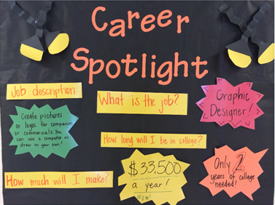
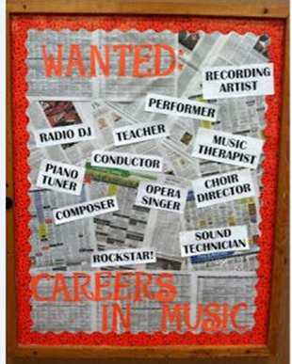
Examples

