Slide 1
Do Now
Take 3 minutes and jot down a time that you forgot about an important event or task?
What could you have done to help you remember?
**Be Prepared to Share Your Answers**

Slide 2
Organization Learning how to Plan
By failing to prepare you are preparing to fail ~ Benjamin Franklin

Slide 3
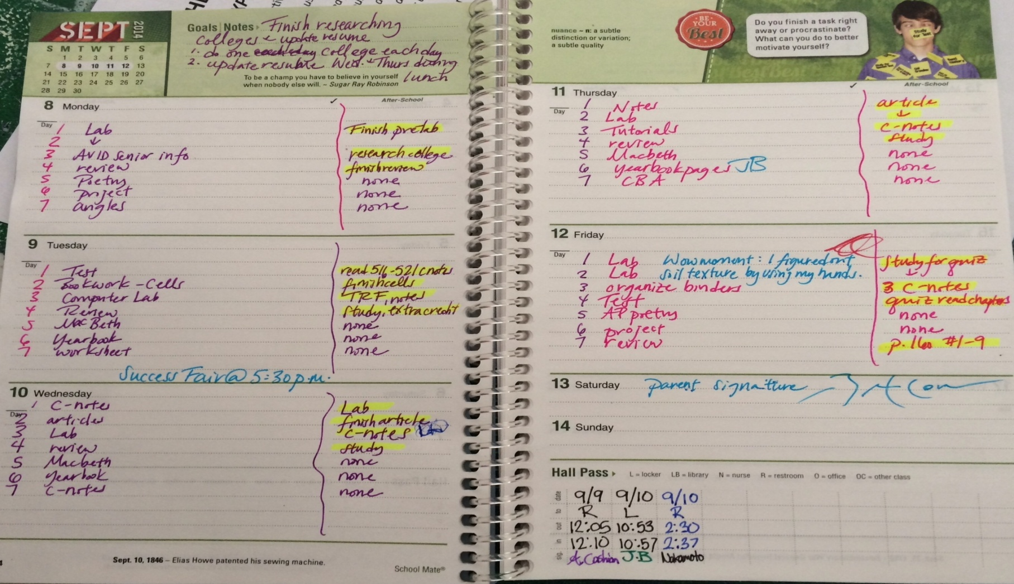
Paper and Pen Exemplar
Assignments
Homework

Slide 4
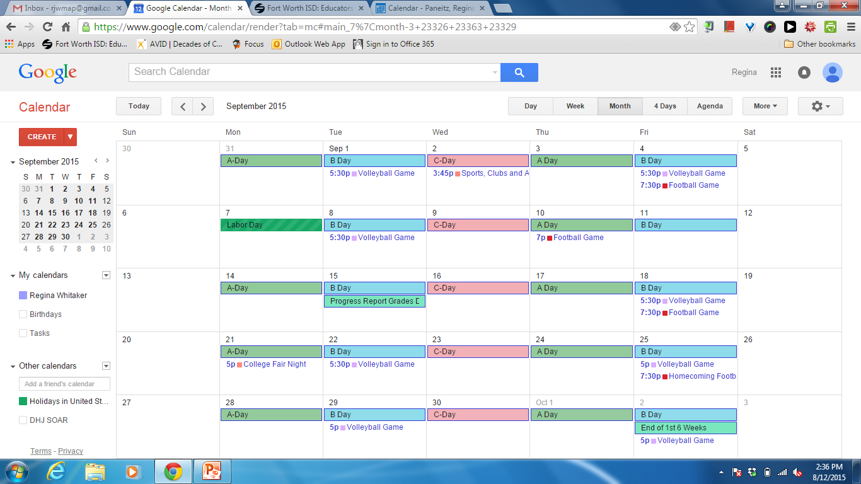
Electronic Exemplar

Slide 5
Planners!
Hand out student planners.
Students take this time to begin to update your planner with important dates.
Birthdays
Beginning and Ending of 6 Weeks
Practices, games

Slide 6
Exit Ticket
As we enter the 1st 6 weeks of school how can you utilize your planner….
Successful?
Prepared?
Organized?

