Slide 1
LET’S BREAK THE ICE!
Advisory August 21, 2017

Slide 2
Team Building (1)
Your Advisory teacher has placed character names on your back as you came in the classroom. DO NOT REMOVE THE NAME! Soon enough you will have an opportunity to guess!
You will make your way around the room. While walking around the room you should introduce yourself to everyone.
After introductions, the other person will give you one word clues to who you are.
Once you figured out who you are, you have to find your partner from the crowd.

Slide 3
Team building (2)
Find a partner.
Sit back to back with your partner.
One partner will get a picture and the other will have a blank piece of paper and a pen.
The person with the picture will give verbal descriptions of their image while their partner attempts to draw the image from the descriptions given.
* You can’t say exactly what the picture is. Example, you can’t tell them that your picture is a dog if you have a picture of snoopy.

Slide 4
Partner Time!
In our group, pick one person preferably near your classroom to cover your advisory class if you are absent a day of advisory.
This person will be your advisory partner for the rest of the year.

Slide 5
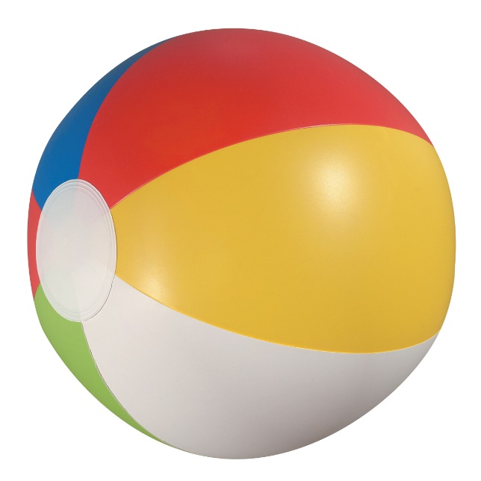
Name Game Ball Toss
In this game have the students stand in a circle.
Give one student the ball and have them say their name before passing it to another student.
The new student will then state the name of the person that passed them the ball before saying their name.
They then toss the ball to someone new and the cycle continues until everyone has participated.

Slide 6
Categories
In this game the students are still in a circle.
Give the group a category from which they will name from. (animals, foods, sports, etc.)
Begin by tossing the ball to one student and have them name an item that begins with the first letter of the Alphabet. (animals “A”= aardvark)
Then they pass or toss the ball to someone new and they have to name an item that begins with the next letter of the alphabet. (animals “B”=bumblebee)
This continues until you reach the end of the alphabet.

Slide 7
Birthday Line Up
Explain to the group that this is a nonverbal exercise.
The group is to form a single straight line according to birthdays. This includes the month and day. No lip reading or spelling is allowed.
When the line is completed each person will shout out their birthday beginning in January.
Alternative: Instead of birthdays, students may line up according to the number of siblings they have.

Slide 8
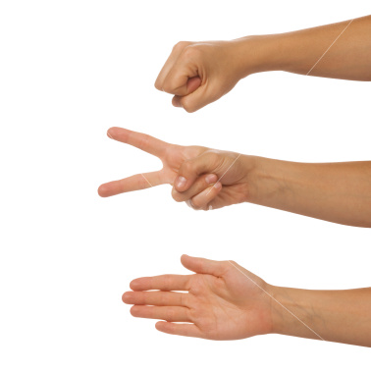
Rock, Paper, Scissors, Tournament
Have students partner up
With their partners students will play rock, paper, scissors.
The loser will have to follow the winner cheering them on as they continue to play on against the other winners in the class

Slide 9
Snowball Fight
Students will write a TRUE and interesting fact about themselves on a scratch piece of paper
Take that piece of paper and crunch it up into a paper ball
Students will have 30 seconds to have a “snowball fight”
After the 30 seconds students should pick up the ball nearest them, read the fact and try to match it to the person that wrote it.

