Slide 1
It’s Grade Check Time
icomets.org

Slide 2
Log Into Focus Week 3 of the 6 Weeks >>Download Grade Reflection Sheet
10 minutes
Notes:
Teacher: 10 minutes
Have students check their grades in focus and fill out the academic action plan.

Slide 3
Class | Current Grade | Missing or Failing Assignments | Why? | Next Step

Slide 4
Email Your Teacher
Open a Chrome window and type in office365.fwisd.org
Log into your email
Open a new message
Choose one class that you are failing and email the teacher your plan to earn a passing grade by the end of the 3rd 6 weeks.
If you are not failing, email a different teacher thanking them for their hard work.
Notes:
10 min
Total 24 min

Slide 5
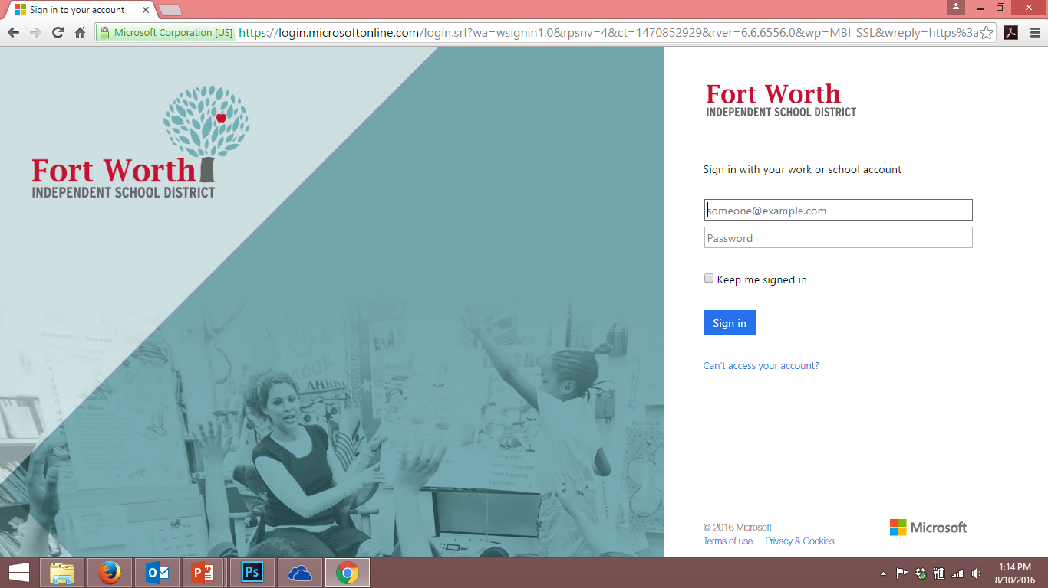
How to log on to your 365 Email
Go to office365.fwisd.org
Log in using your school information with a small change
Username – s(school id)@stu.fwisd.org
Password – Same as your regular log in

Slide 6
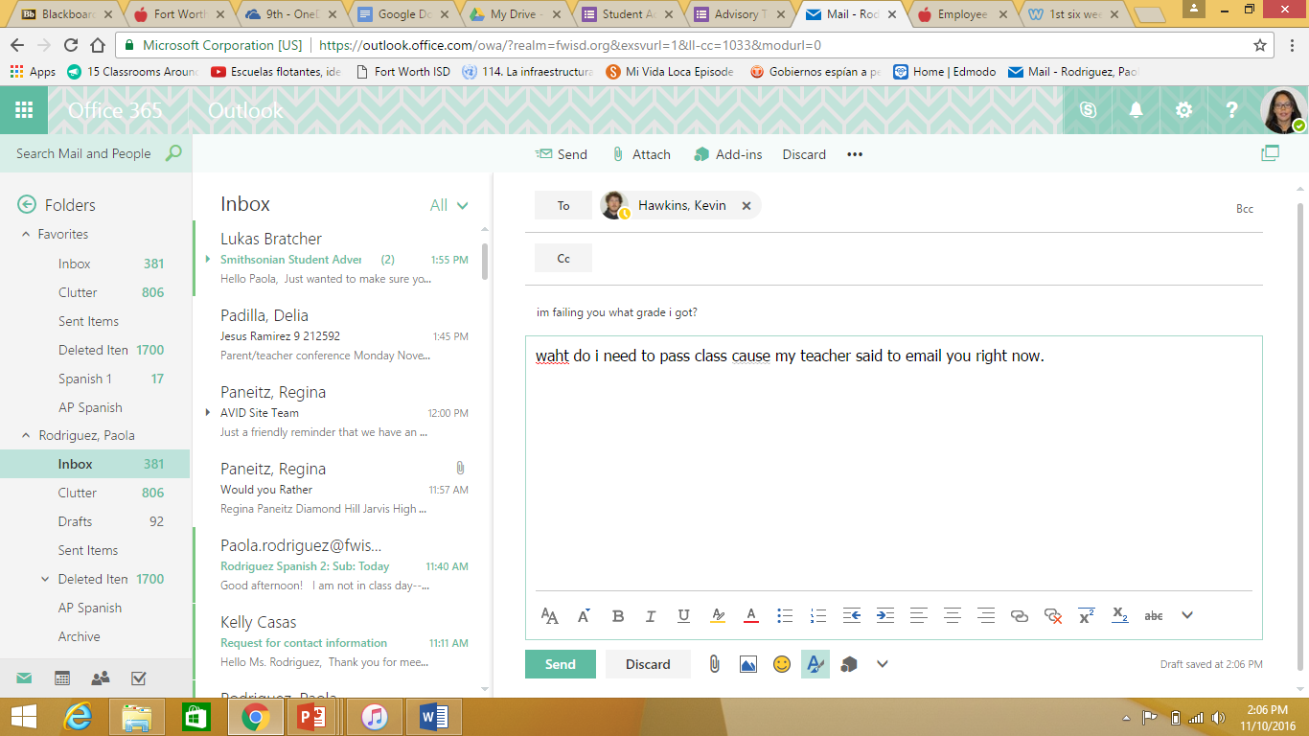
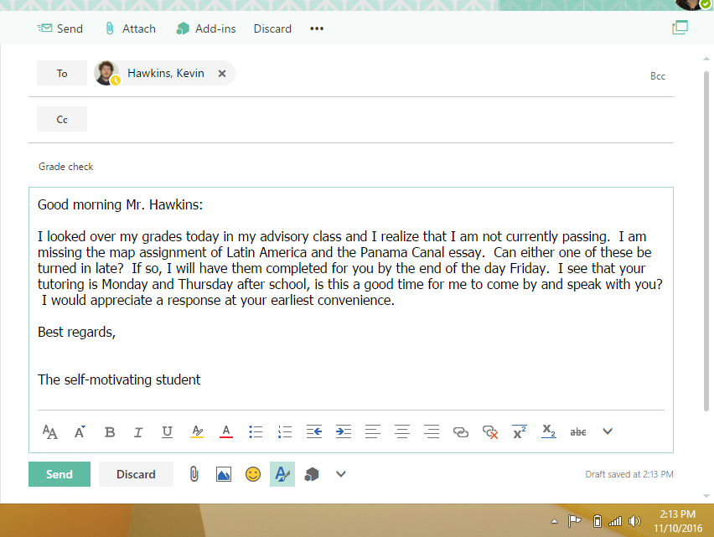
What should my email look like?

Slide 7
What you need to include in your email…
Subject line is short and to the point
Include a greeting
In the body of your email include:
Your missing assignments specifically
Ask what can be turned in
Your specific plan of when you will turn in the work
How will you follow up
Closing

Slide 8
Compose your Email
Make sure you that you include your advisory teacher in the CC space of the email.

Slide 9
Study Hall
You now have the rest of the period to work on assignments for other classes.

