Slide 1
Explanation of Grades to Numbers
WHAT IS GPA?

Slide 2
Total Score
1st Six Weeks + 2nd Six Weeks + 3rd Six Weeks =
210 = C
243 = B
273 = A
1st ______ + 2nd ______ + 3rd ______ = ___?___

Slide 3
Look at your grade report
Focus is always the most up-to-date resource for checking your grade.
Make sure you are in the current six weeks.

Slide 4
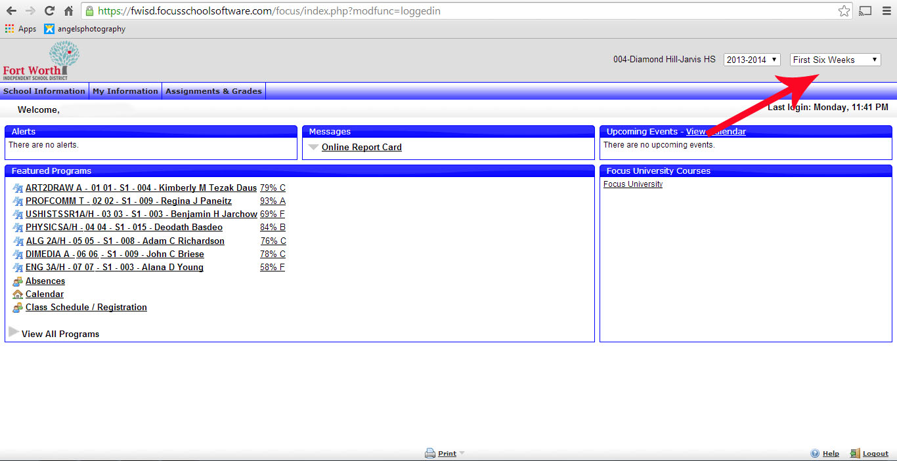

Slide 5
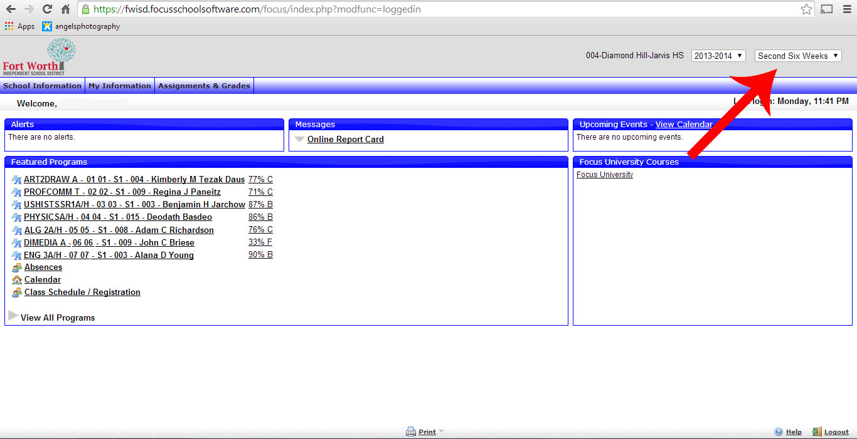

Slide 6
What Grade do I need?
Enter your 1st and 2nd six weeks onto the chart
Figure out what you need this six weeks for a
C B
210 – 1st - 2nd = 3rd 243 – 1st - 2nd = 3rd
A
273 1st - 2nd = 3rd

Slide 7
New GPA Guidelines
An “A” does NOT = 4.0
A “B” does NOT = 3.0
A “C” does NOT = 2.0
Different scores and classes have different value.
AP/D.C. = 5
Honors = 4.5
All others = 4

Slide 8
Guide to Grade Reporting

Slide 9
Time for some more math!
Figure out your current GPA in each class.
Add 1st + 2nd and divide the sum by 2
This is your current average. Compare this number to the chart and calculate your GPA

Slide 10
Guide to Grade Reporting

