Slide 1
Advisory 8/25
Growth Mindset
-Please advise your students that next week will be the door decoration competition and that they should bring supplies!

Slide 2
★★★
1 | What is a growth mindset?
2 | How can developing a growth mindset help me?
3 | What do I need to do next?

Slide 3
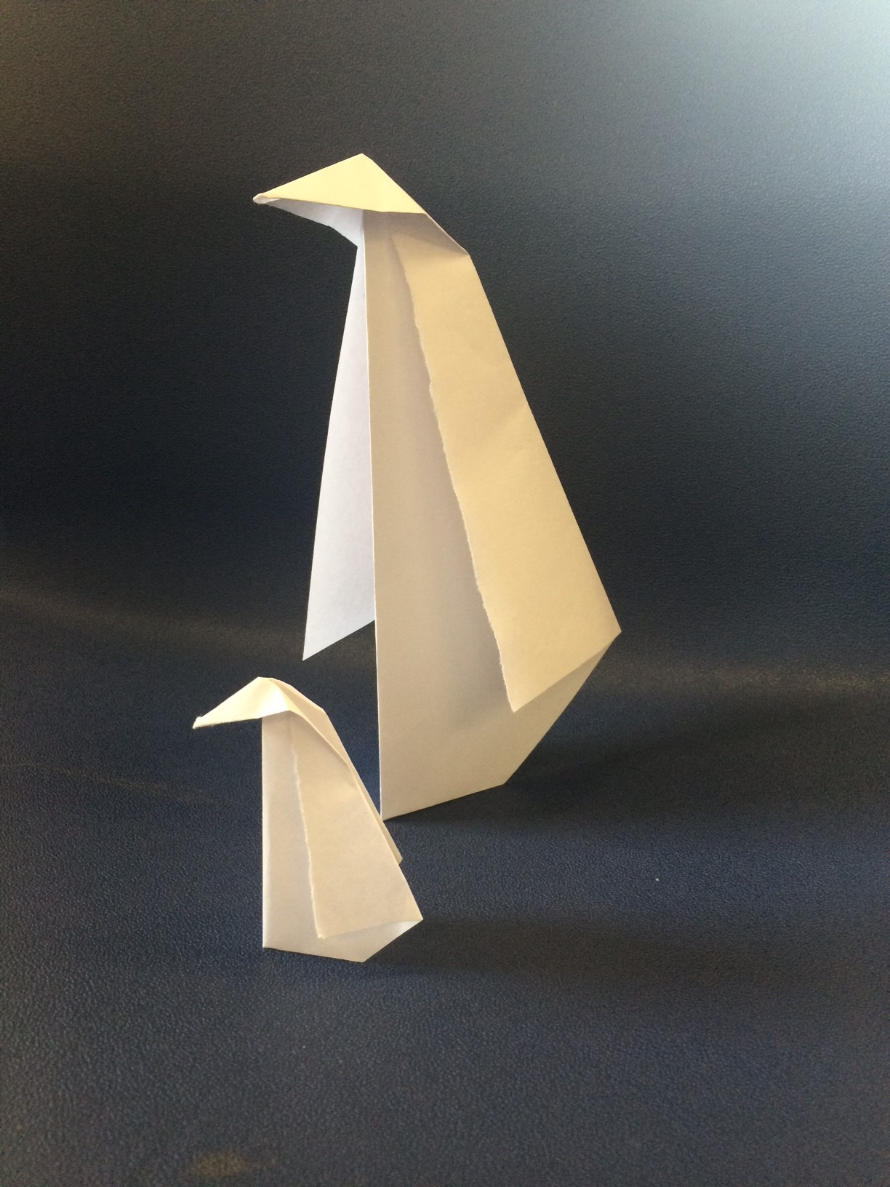
Your challenge is to create an origami penguin from the sheet of paper in front you. Good luck!

Slide 4
?

Slide 5
Did you give up immediately?
Did you try and then give up?
Did you expect to fail?
Did you expect to succeed?

Slide 6
★★★
1 | What is a growth mindset?
2 | How can developing a growth mindset set help me?
3 | What do I need to do next?

Slide 7
A mindset is an attitude that determines how you will interpret and respond to situations.

Slide 8
A growth mindset is characterized by the belief that skills and abilities can be developed over time, through dedication and hard work.

Slide 9
★★★
1 | What is a growth mindset?
2 | How can developing a growth mindset set help me?
3 | What do I need to do next?

Slide 10
✗ | Avoid challenges
✗ | Give up easily
✗ | See making an effort as being pointless
✗ | Ignore all feedback that is not positive
✗ | Feel threatened by the success of others

Slide 11
★ | Embrace challenges
★ | Persist in the face of setbacks
★ | See effort as the path to mastery
★ | Learn from criticism
★ | Be inspired by the success of others

Slide 12
1 | Your strongest subjects
2 | The subjects that require improvement
3 | Barriers to your learning
 | For example, do you find it difficult to memorize and use key words?
4 | Actions that will help to fulfil your potential
 | For example, do you need to improve the technical accuracy of your writing?

Slide 13
★★★
1 | What is a growth mindset?
2 | How can developing a growth mindset set help me?
3 | What do I need to do next?

Slide 14
Ahead of you, you will face many challenges. Developing a growth mindset will be an important factor in enabling you to succeed.

Slide 15
I want you to have another go at creating an origami penguin, but this time you’ll have instructions.
I want the penguin to be a reminder to you that, over time and with a bit of help and a positive attitude, everyone can achieve success.

Slide 16
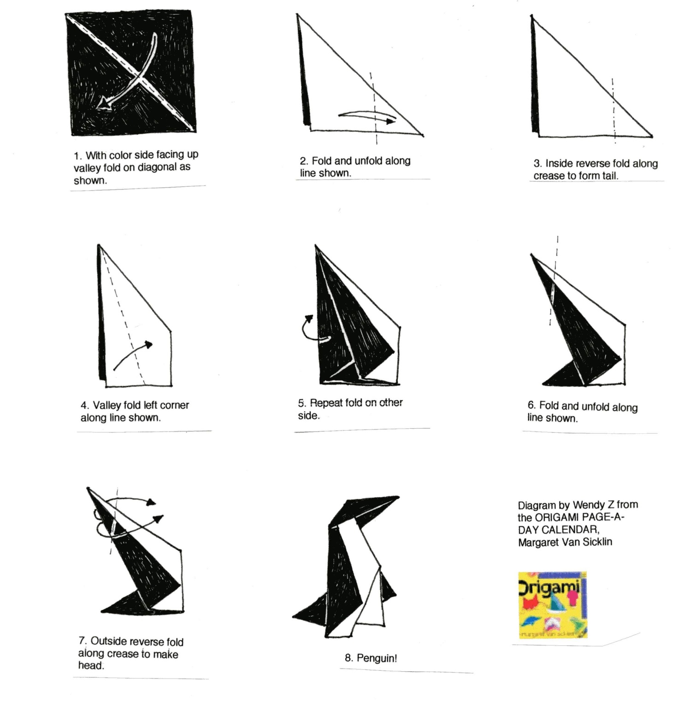

Slide 17
