Slide 1
Next week is Homecoming!!!

Slide 2
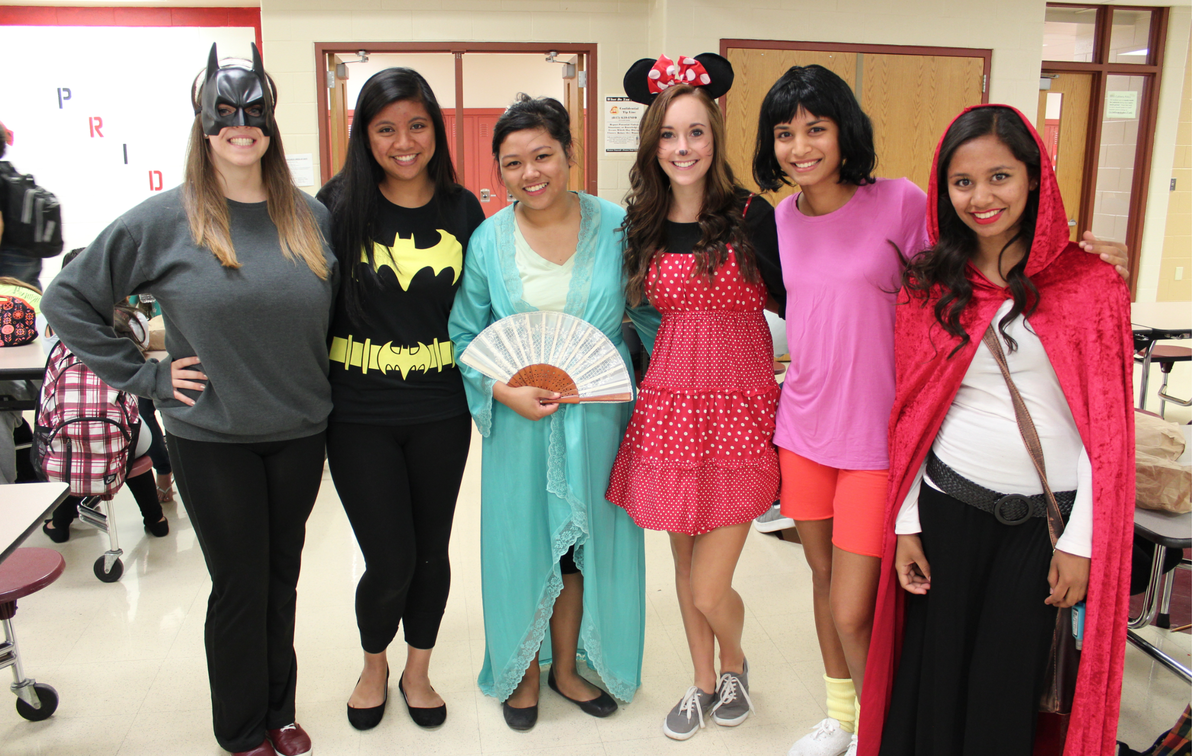
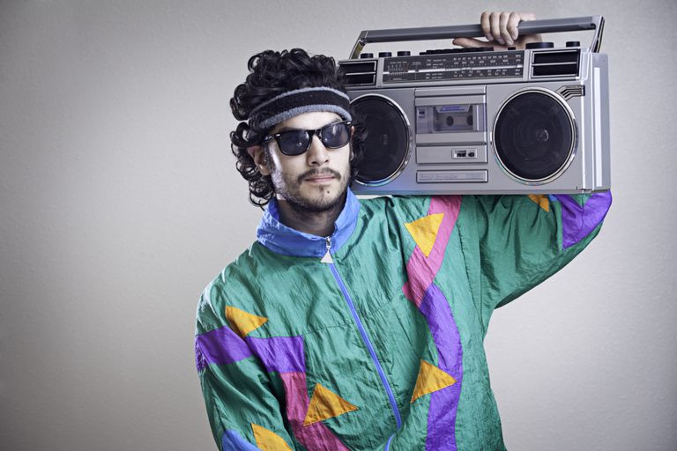
HOMECOMING DRESS UP DAYS
MONDAY: CHARACTER DAY
DRESS AS YOUR FAVORITE CHARACTER FROM TV, MOVIES, AND BOOKS
TUESDAY: HAWAIIAN DAY
WEAR YOUR BEST HAWAIIAN ATTIRE
WEDNESDAY: WACKY TACKY DAY
WEAR YOUR WACKIEST AND TACKIEST OUTFIT
THURSDAY: THROWBACK THURSDAY
DRESS IN YOUR FAVORITE DECADES ATTIRE
FRIDAY: SPIRIT DAY
WEAR YOUR SPIRIT SHIRT

Slide 3
12th grade court voting
TEACHERS PLEASE HAVE YOUR STUDENTS COMPLETE THE FORM.
ONE PER PERSON
https://goo.gl/forms/4CcftJx9EO4Gzslu2

Slide 4
Grade check
Check your grades on focus
IF you are failing or have questions about a grade, email your teacher and CC your advisory teacher

