Slide 2
Understanding your transcript
SOAR
Grade 11

Slide 3
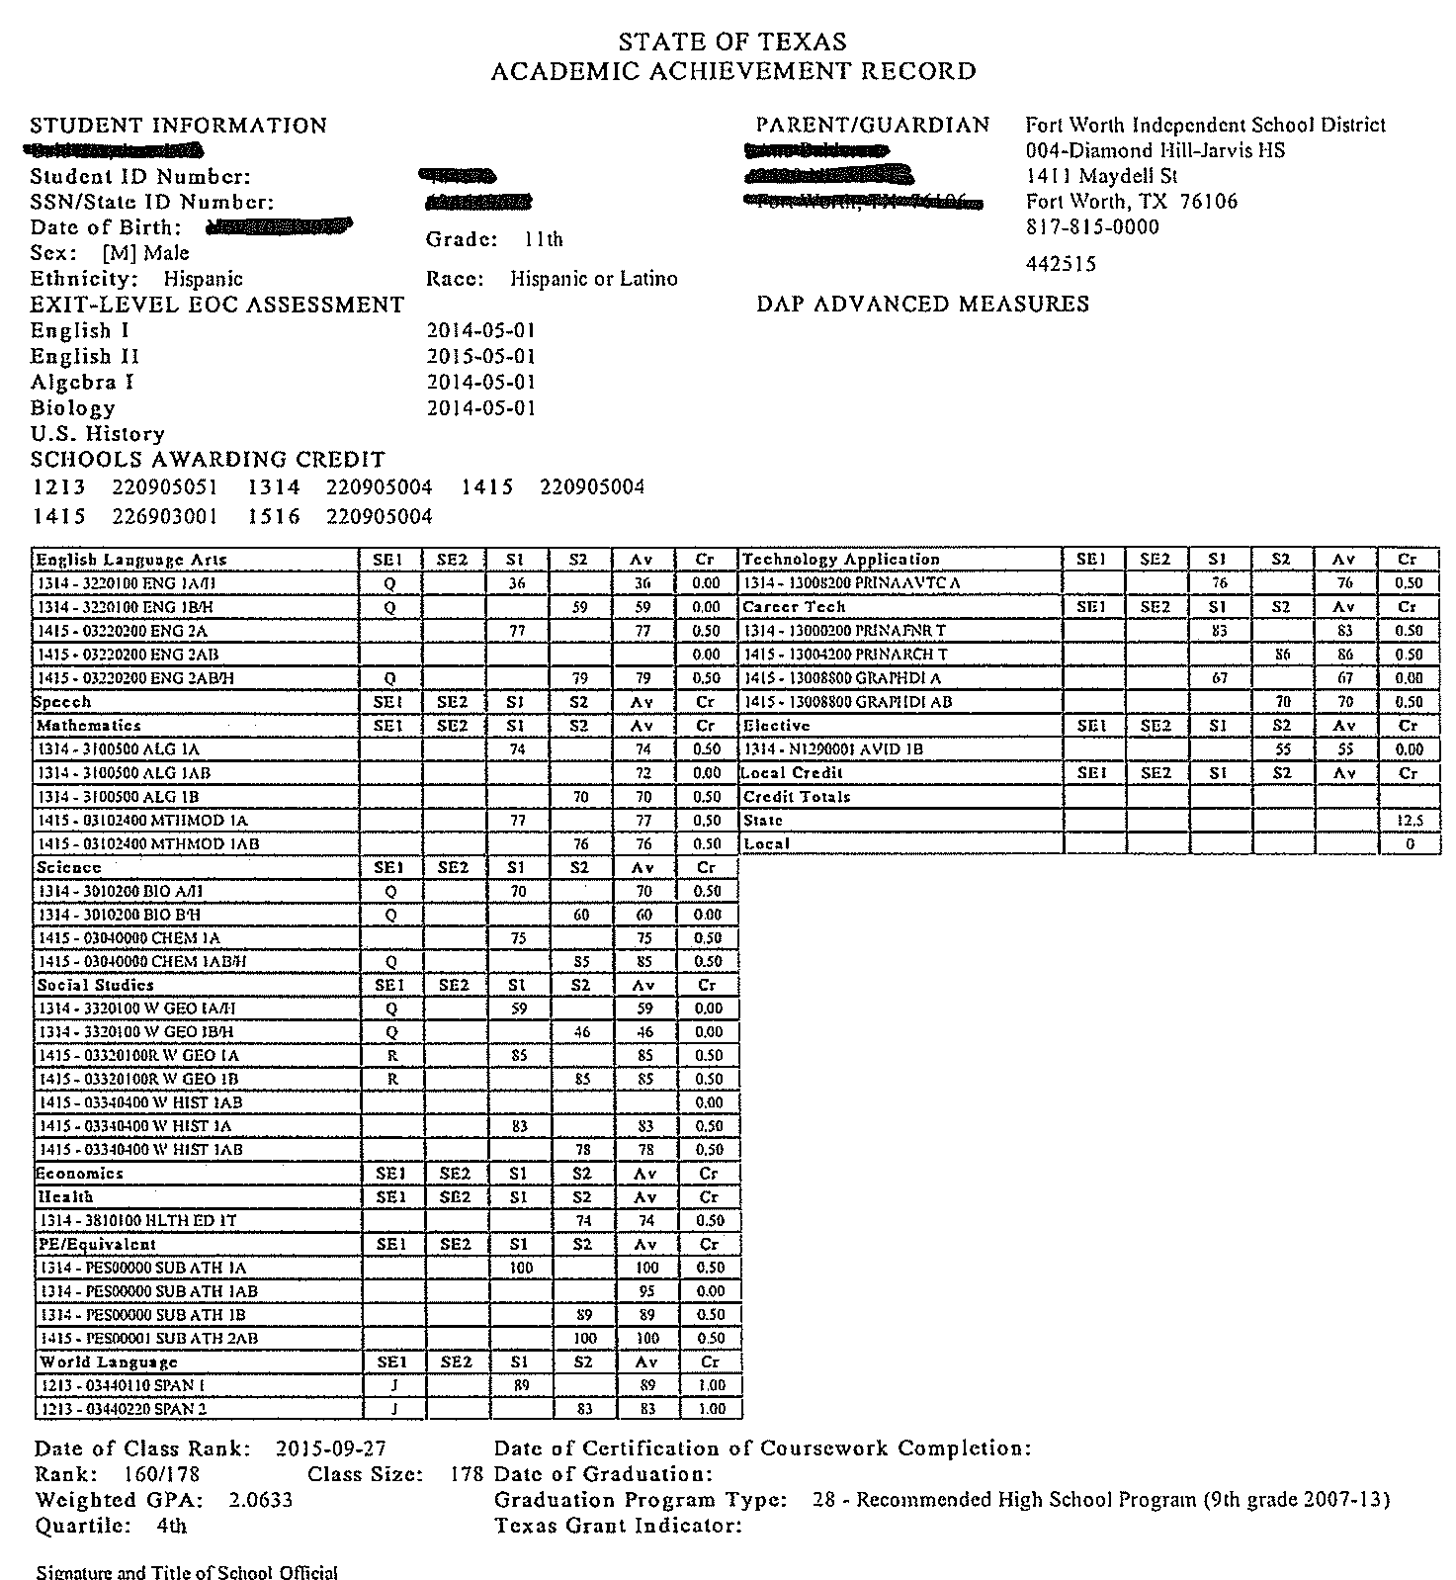
This is a sample of an Academic Achievement Record – or TRANSCRIPT of an inactive (withdrawn) student.
Follow along on your transcript as we discuss each part.

Slide 4
Your personal information is on top. Name, Date of Birth, ID number, etc.

Slide 5
Here it indicates which STAAR EOC exams you have passed. If it is blank – you still need to pass that subject.
If you believe any of this information is inaccurate or incomplete – you need to let Ms. Paulson know ASAP.

Slide 6
This section shows every class you have taken for high school credit. Let’s look carefully at this section. . .

Slide 7
The first class listed is English I.
This student earned grades of 36 for semester 1 and 59 for semester 2.
The two grades do not average to a passing score for 1.0 credit.

Slide 8
Let’s look at another one……
The student took W. Geography Honors.
Notice there is a “Q” code.
There is a legend key on the bottom of your transcript to see what “Q” and all other letters represent. “Q” means this was a honors course. He/She didn’t receive the credit. Weighted courses help your GPA and ranking if you earn higher grades.

Slide 9
Oh Noooooo!!!!!
The student did not earn a “70” or higher . . . .
Therefore, credit was not awarded.
However, the student retook the courses in summer school indicated by the “R” code.

Slide 10
Let’s Review that one more time!
By not earning a 70 in the course, this student:
Lowered his/her GPA and rank drastically!
Needs to retake and pay for the course in summer school.

Slide 11
Your TOTAL Credits are listed here.
You needed 12 credits to be classified as a junior at the beginning of the year.
19 credits to be classified as a senior
You need 26 credits to graduate recommended.

Slide 12
This is your class rank. This student is 160 out of 178.

Slide 13
This is your weighted GPA. “Weighted” means that honors, AP, and Dual Credit courses count more heavily in your GPA.
See next page for more details.

Slide 14
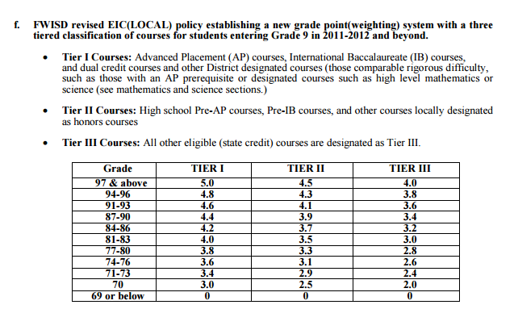
Here is the chart for calculating GPA. Note AP and Dual Credit courses carry the most weight – Tier 1 Courses.
Tier 2 includes Pre-AP courses (Honors).
Tier 3 includes all other courses.
If you have questions about GPA – see Ms. Paulson! ☺

Slide 15
QUARTILE –
This student is in the 4th quartile.
More info to come on this later – but your goal is to be in the FIRST quartile, the top 25% of the class. With a class size of 178, that would be those students ranked 44 or higher. BUT REMEMBER, our class size is closer to 200. So those ranked 50 or higher are in the best shape!!
See Ms. Paulson for more information.

Slide 16
Whew!!!!!
That is a LOT of information in a short amount of time.

Slide 17
Follow us on Facebook, Twitter, and Instagram to get the latest Counseling information and updates!

