Slide 2
Understanding your transcript
SOAR
Grade 10

Slide 3
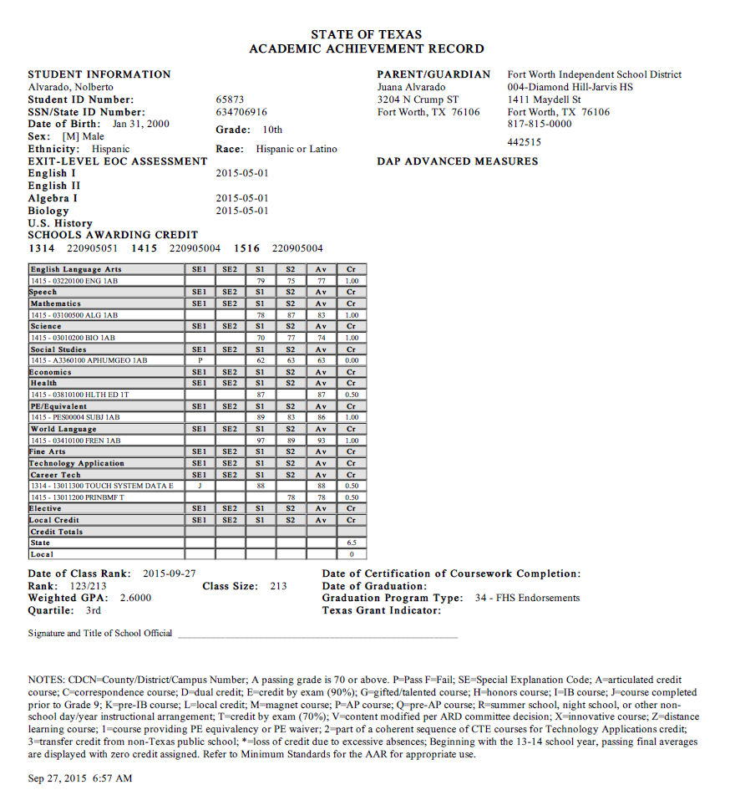
This is a sample of an Academic Achievement Record – or TRANSCRIPT.
Follow along on your transcript as we discuss each part.

Slide 4
Your personal information is on top. Name, Date of Birth, ID number, etc.

Slide 5
Here it indicates which STAAR EOC exams you have passed. If it is blank – you still need to pass that subject.
If you believe any of this information is inaccurate or incomplete – you need to let Ms. Kinzer know ASAP.

Slide 6
This section shows every class you have taken for High School credit. Let’s look carefully at this section. . .

Slide 7
The first class listed is English I.
This student earned grades of 79 for semester 1 and 75 for semester 2. (Which averaged to a 77)
Therefore, the student earned 1 full credit.

Slide 8
Let’s look at another one……
The student took AP Human Geography.
Notice there is a “P” code.
Look at the key below to see what “P” represents. “P” means this was an AP Course. This is important!! This means the course is weighted more heavily on the GPA.

Slide 9
Oh Noooooo!!!!!
The student did not earn a “70” or higher . . . .
Therefore, credit was not awarded.
That is going to negatively affect their GPA, too!! ARGGGGG!!!

Slide 10
Let’s Review that one more time!
By not earning a 70 in the course, this student:
Wasted a whole year not earning a credit.
Lowered his/her GPA.
Has to spend time retaking either AP Human Geography or the equivalent, World Geography.
ARRRGGGG!!! DON’T DO THAT! Earn your credits!!!! (Little bit of a side-lecture from Ms. Kinzer! ☺)

Slide 11
Your TOTAL Credits are listed here.
You needed 6 credits to be classified as a sophomore at the beginning of the year.
You need 12 credits to be classified as a junior next year.

Slide 12
This is your class rank. This student is 123rd out of 213.
(This number is misleading. That means there are 213 students classified as 10th graders. This includes repeat 11th and/or 12th graders so that number is going to change. There are only about 185 TRUE sophomores! – I’ll talk to you more about this soon.)

Slide 13
This is your weighted GPA. “Weighted” means that honors, AP, and Dual Credit courses count more heavily in your GPA.
See next page for more details.

Slide 14
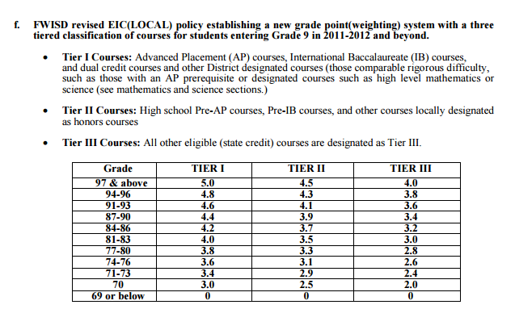
Here is the chart for calculating GPA. Note AP and Dual Credit courses carry the most weight – Tier 1 Courses.
Tier 2 includes Pre-AP courses (Honors).
Tier 3 includes all other courses.
If you have questions about GPA – see Ms. Kinzer!! ☺

Slide 15
QUARTILE –
This student is in the 3rd quartile.
More info to come on this later – but your goal is to be in the FIRST quartile, the top 25% of the class. With a class size of 213, that would be those students ranked 53rd or higher. BUT REMEMBER, our class size is closer to 185. So those ranked 46 or higher are in the best shape!!
See Ms. Kinzer if you have pressing questions on this.

Slide 16
Whew!!!!!
That is a LOT of information in a short amount of time.
REMEMBER – Ms. Kinzer is here for you. Stop by any time, email, call ….

Slide 17
Follow us on Facebook, Twitter, and Instagram to get the latest Counseling information and updates!

